Slide 1
FPGA Implementation of CNN Handwritten Character Recognition
TEAM POOR HANDWRITING
Qikun LIU, Shichen (Justin) QIAO, Haining QIU, Lingkai (Harry) ZHAO
ECE 554 SP 2023 Final Presentation

Slide 2

Agenda
Introduction and Overview
32-Bit Floating Point ISA and the Extended ALU
Processor Expansions and Memory Management
Camera Interface and Peripheral Device Utilizations
Image Processing Units - Compression, Padding, and Storage
Machine Learning Software - LC, NN, and CNN
Self-Checking Assembly Tests and Python Auto-Tester
Assembly Firmware - Parameterized Machine Learning API
Potential Impacts and Future Advancements

Slide 3
Introduction and Overview
Project Goals and Video Demo

Slide 4
Project Goals
Design a 32-bit general purpose processor that is fully compliant to the IEEE-754 Floating Point Standard
Implement real-time digital image processing
Practice various computer engineering protocols
Achieve edge-computing and acceleration of complex Machine Learning architectures

Slide 5
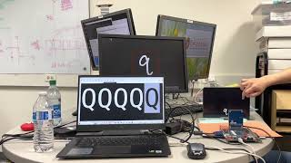
Video Demo

Slide 6
32-bit Floating Point ISA and the Extended ALU
Customized Instruction Set Architecture and IEEE-754-Compliant Compute Units Implemented in System Verilog

Slide 7
Instruction Set Architecture (Extended Part)
PUSH | aaaa_axxx_xxxx_xxxx_xxxs_ssss_xxxx_xxxx | PUSH R1 | 5'b10010 | DataMem[SP] <= R1; Decrement SP | Stores value in R1 into data memory pointed by the stack pointer; decrements stack pointer
POP | aaaa_axxx_xxxd_dddd_xxxx_xxxx_xxxx_xxxx | POP R1 | 5'b10011 | R1 <= DataMem[SP]; Increment SP | Loads value in data memory pointed by the stack pointer into R1; increments stack pointer
ADDI | aaaa_axxx_xxxd_dddd_xxxs_ssss_iiii_iiii | ADDI R1, R2, I | 5'b10100 | R1 <= R2 + C | I is 8-bit signed immediate value. Updates the Z, V and N flag registers
SUBI |  | SUBI R1, R2, I | 5'b10101 | R1 <= R2 - C
MUL | aaaa_axxx_xxxd_dddd_xxxs_ssss_xxxt_tttt | MUL R1, R2, R3 | 5'b11000 | R1 <= (signed) R2[15:0] * (signed) R3[15:0] | Only support 16 by 16 multiplications
UMUL |  | UMUL R1, R2, R3 | 5'b11001 | R1 <= (unsigned) R2[15:0] * (unsigned) R3[15:0]
ADDF |  | ADDF R1, R2, R3 | 5'b11010 | R1 <= R2 + R3 (floating-point) | Floating point calculation 1-bit sign, 8-bit exponent, 23-bit mantissa ADDF, SUBF, MULF will set the flags for branch. However, ITF and FTI will not set the flags for branch.
SUBF |  | SUBF R1, R2, R3 | 5'b11011 | R1 <= R2 - R3 (floating-point)
MULF |  | MULF R1, R2, R3 | 5'b11100 | R1 <= R2* R3(floating-point)
ITF | aaaa_axxx_xxxd_dddd_xxxs_ssss_xxxx_xxxx | ITF R1, R2 | 5'b11101 | R1 <= R2 (integer to floating-point)
FTI |  | FTI R1, R2 | 5'b11110 | R1 <= R2 (floating-point to integer)

Slide 8
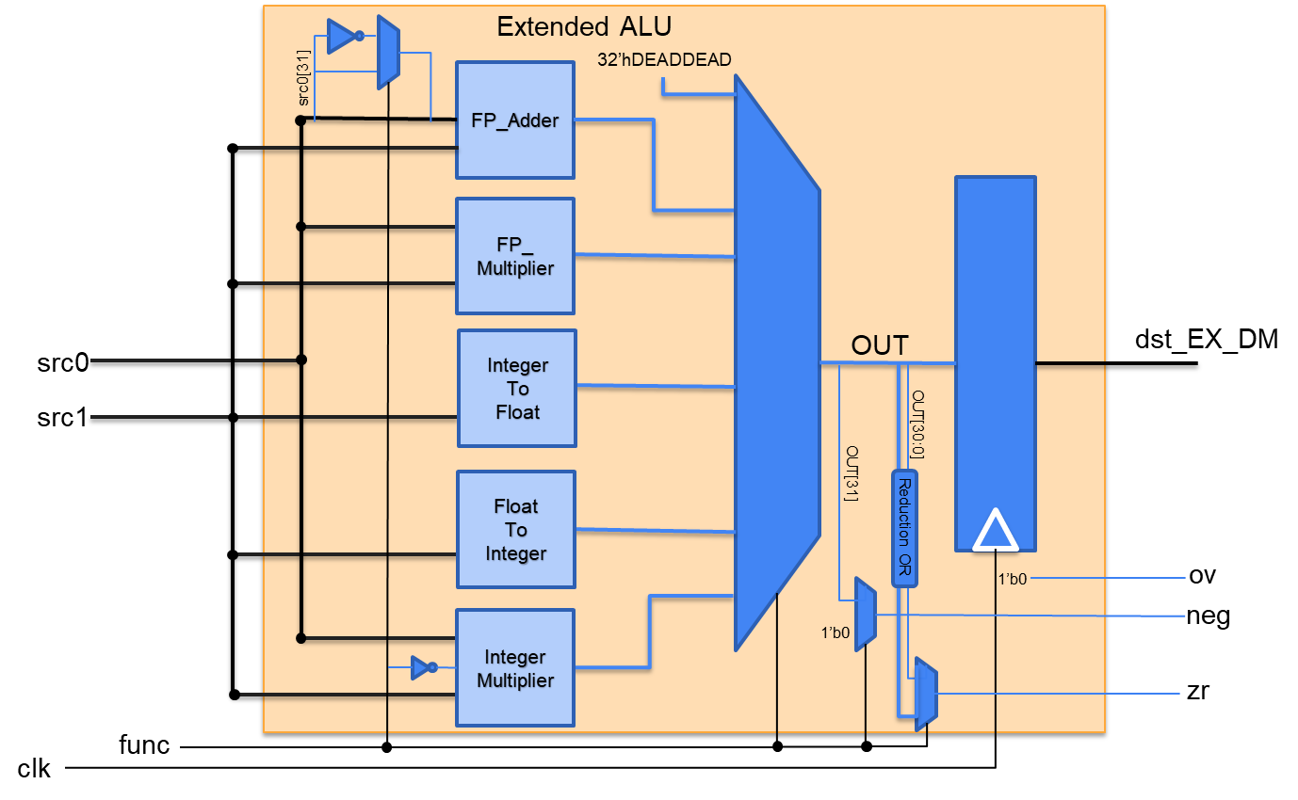
The Extended ALU

Slide 9
IEEE-754 Floating Point Standard
s
eeee_eeee
mmm__mmmm_mmmm_mmmm_mmmm_mmmm
Normal value = (-1)^S * 2^(E-127) * (1.M)
Denormalized when |E = 0, value = (-1)^S * 2^(E-127) * (0.M)
+0 = 32'h0000_0000, -0 = 32'h8000_0000
+INF = 32'h7F80_0000, -INF = 32'hFF80_0000
0x00000001 = 2^−126 × 2^−23 = 2^−149 ≈ 1.4012984643 × 10^−45 (smallest positive denormalized number)
0x007fffff = 2^−126 × (1 − 2^−23) ≈ 1.1754942107 ×10^−38 (largest denormalized number)
0x00800000 = 2^−126 ≈ 1.1754943508 × 10^−38 (smallest positive normal number)
0x7f7fffff = 2^127 × (2 − 2^−23) ≈ 3.4028234664 × 10^38 (largest normal number)

Slide 10
Floating Point Multiplication
1. Breaking the inputs into {S1, E1, M1} and {S2, E2, M2}. 2. The signs are XORed to determine the sign of the product. 3. The exponents are added together with the 127 offsets accounted for. 4. The mantissa are then appended with an implicit 1 (or 0 when denormalized) and multiplied. 5. Special values like -INF, -0, +0, and +INF require special combinational logic to adjust the outputs. 6. The resulting values are then concatenated and normalized when possible.

Slide 11
Floating Point Addition
1. Compare the exponents and determine the smaller ones. Calculate the absolute difference between the exponents; the larger exponent will be the common exponent.
2. Prepend the common exponent to both mantissa, making them both 24-bit in length.
3. Shift the mantissa with the smaller exponent to the right, using the lower 5 bits of the exponent difference as the shift amount. The maximum shift amount should be 22-bit.
4. Convert both appended and shifted mantissa to 2's complement format. This makes both numbers 25-bit in length.
5. Add the two 25-bit numbers, and if the result overflows positively or negatively. Note that this overflow is an internal overflow, not an external value overflow.
6. Convert the 25-bit 2's complement result to a 25-bit signed number, where the MSB is the final sign, and the rest 24-bit is the unsigned value. If this 24-bit prepended mantissa starts with 0, but no internal occurs, denormalize the common exponent to 0.
7. If an overflow occurs, shift the lower 24-bit to the right and append 1 in the MSB, or shift the lower 24-bit to the left if it has leading zeros. The common exponent, if not 0, is adjusted accordingly.
8. The resulting mantissa is the lower 23-bit of the final 24-bit result, and the exponent is the final common exponent. The sign is the MSB of the final result.

Slide 12
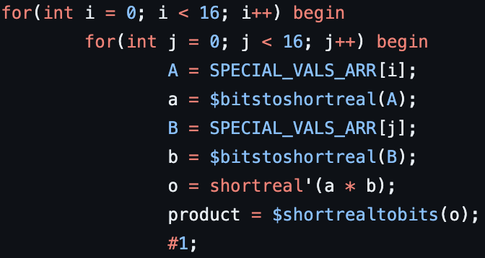
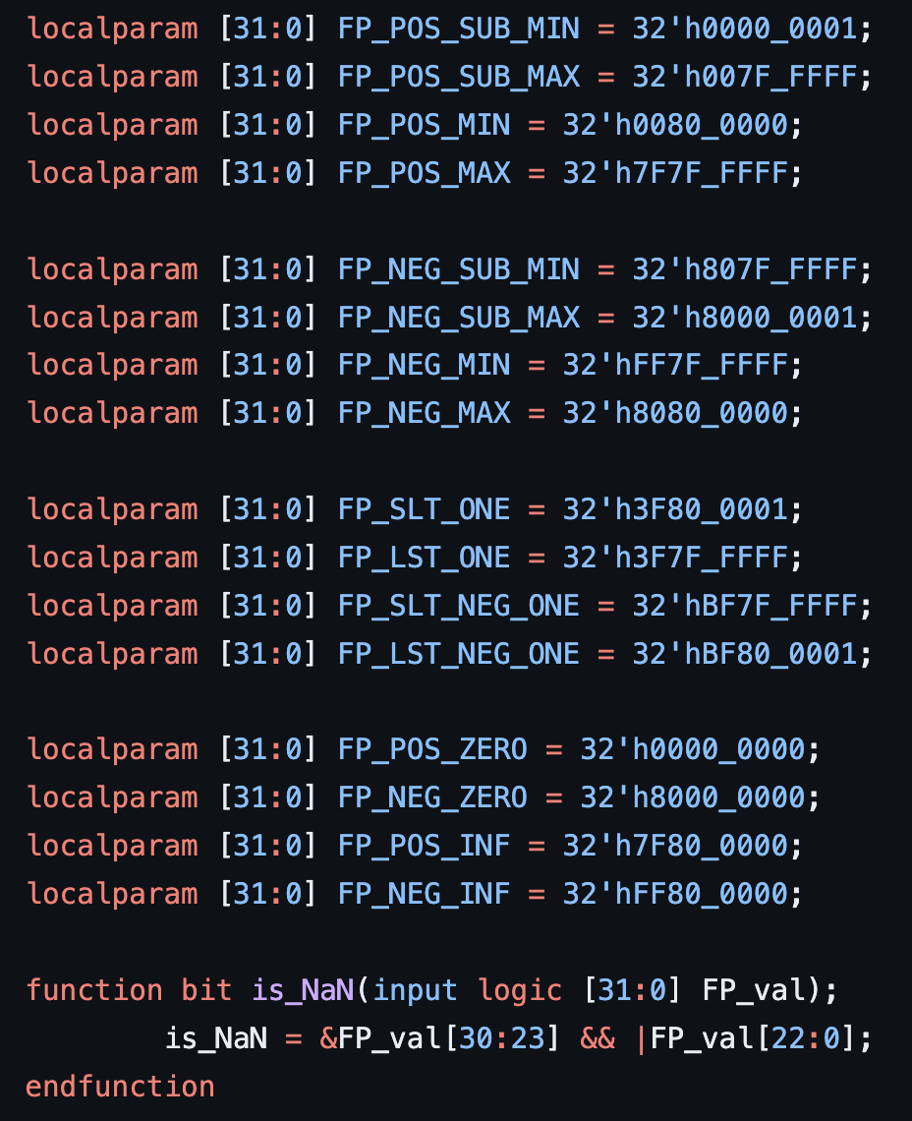
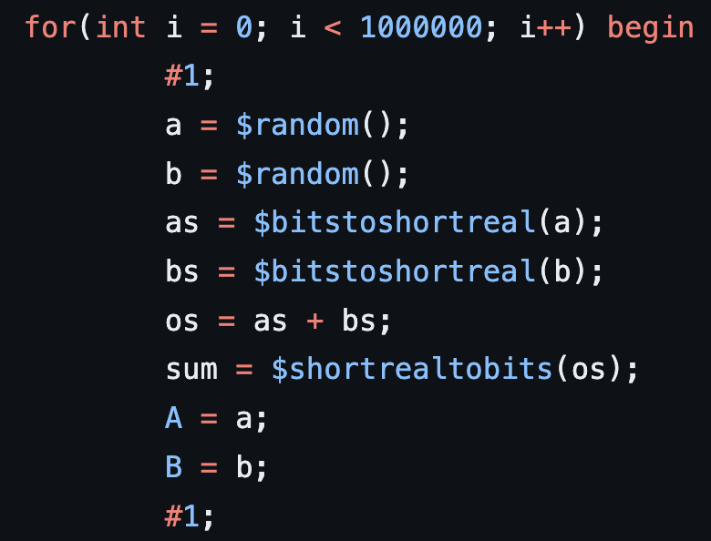
Extended ALU Testbenches

Slide 13
Processor Expansions and Memory Management
Expanded 32-Bit 5-Stage Processor

Slide 14
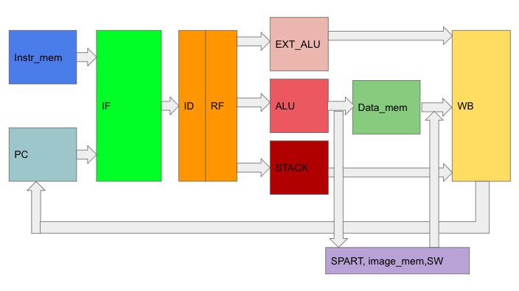
CPU toplevel

Slide 15
Modifications to expand the CPU
Increase all data path from 16 bits to 32 bits
Instruction/Data Memory: increase width from 16 bits to 32 bits
Increase number of registers from 16 to 32 in rf
Added Extend_ALU and stack to the execute stage

Slide 16
Camera Interface and Peripheral Device Utilizations
Digital Camera, External SDRAM, VGA, SPART, and Beyond

Slide 17
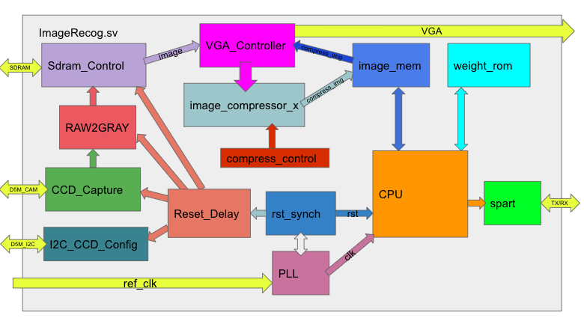
Project Top Level
Image display and process
Compressed image storage
Full Image storage
Camera Interface
Process Firmware Instructions

Slide 18
Image Processing Units - Compression, Padding, and Storage
Converting Real Time Image Captures to ML Classification Inputs

Slide 19
Compression & Padding
Compression
Padding
a
a
224x224
28x28
32x32
640x480

Slide 20
Machine Learning Software - LC, NN, and CNN
Python Software for Training and Dumping ML Kernels and Weights

Slide 21
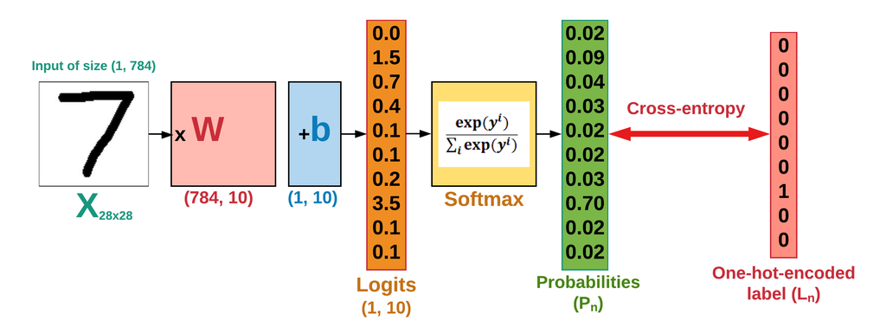
Linear Classification - Softmax loss function
Accuracy: 89%
Accuracy: 67% with letters
https://www.easy-tensorflow.com/tf-tutorials/linear-models/linear-classifier

Slide 22
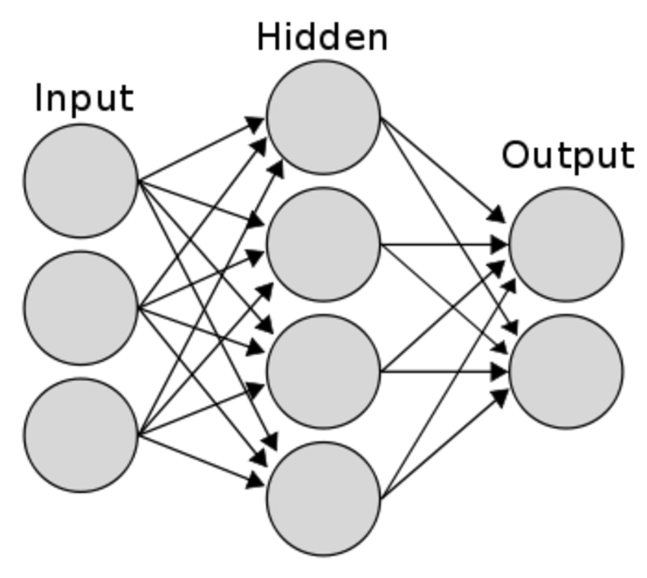
Neural Network
Hidden size
64
Input size
28*28 = 784
Output size
36
Accuracy: 91% with letters
Not enough memory space
https://www.researchgate.net/figure/A-typical-two-layer-neural-network-Input-layer-does-not-count-as-the-number-of-layers-of_fig4_282997080

Slide 23

Solution: Compress Input Data?
6x6 -> 5x5
https://deeplizard.com/learn/video/YRhxdVk_sIs

Slide 24
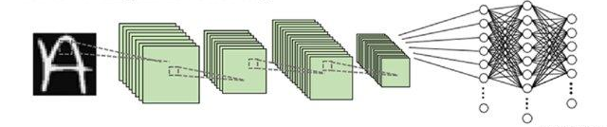
Convolutional Neural Network
400*120
120*84
(6*1*5*5)
(2*2, 2)
(16*6*5*5)
(2*2, 2)
84*36
Input size
32*32 = 1024
1*36
(28*28*6)
(14*14*6)
(10*10*16)
(5*5*16)
= 400
1*400
1*84
1*120
https://www.researchgate.net/figure/Methodology-A-convolutional-neural-network-CNN-was-trained-to-classify-handwritten_fig1_343547826

Slide 25
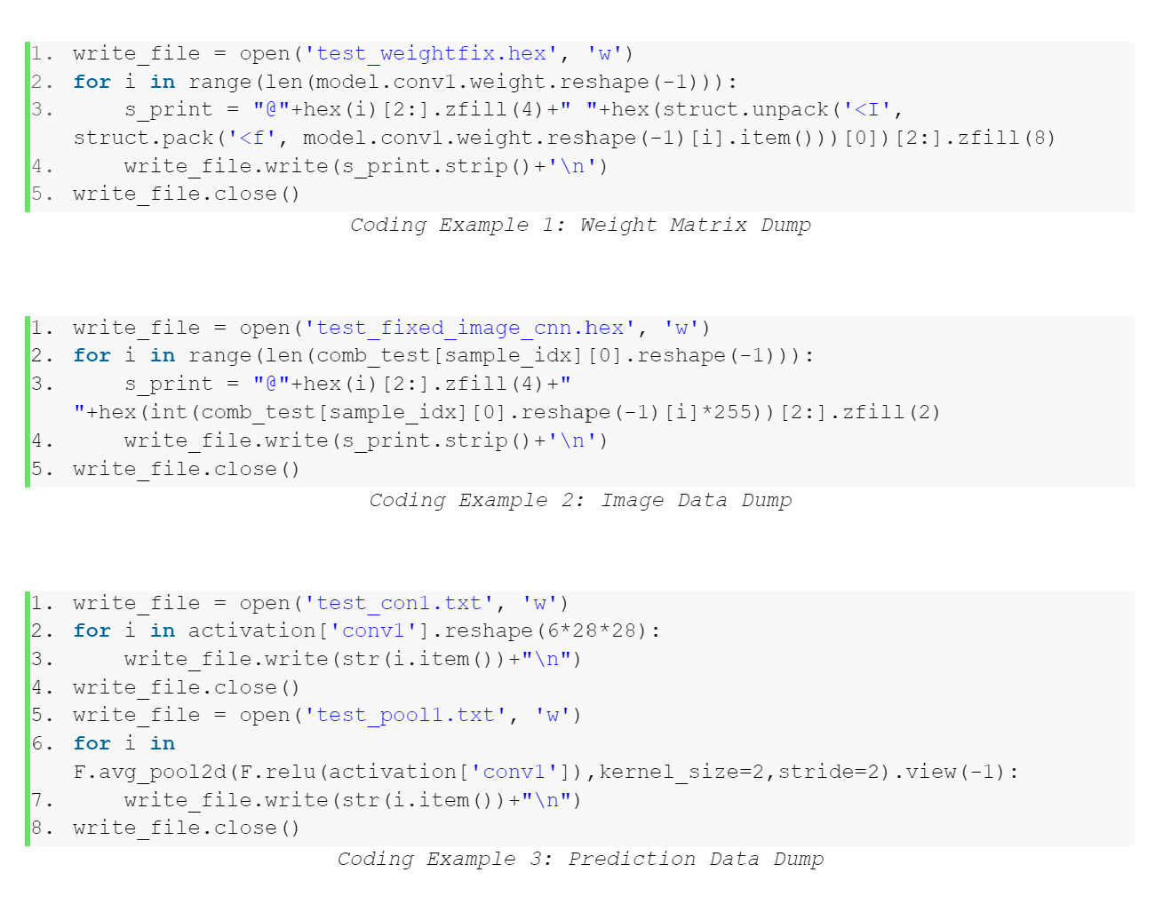
Dumping Required Data
Model Weights
Testing Image
Middle Layer Hidden Data

Slide 26
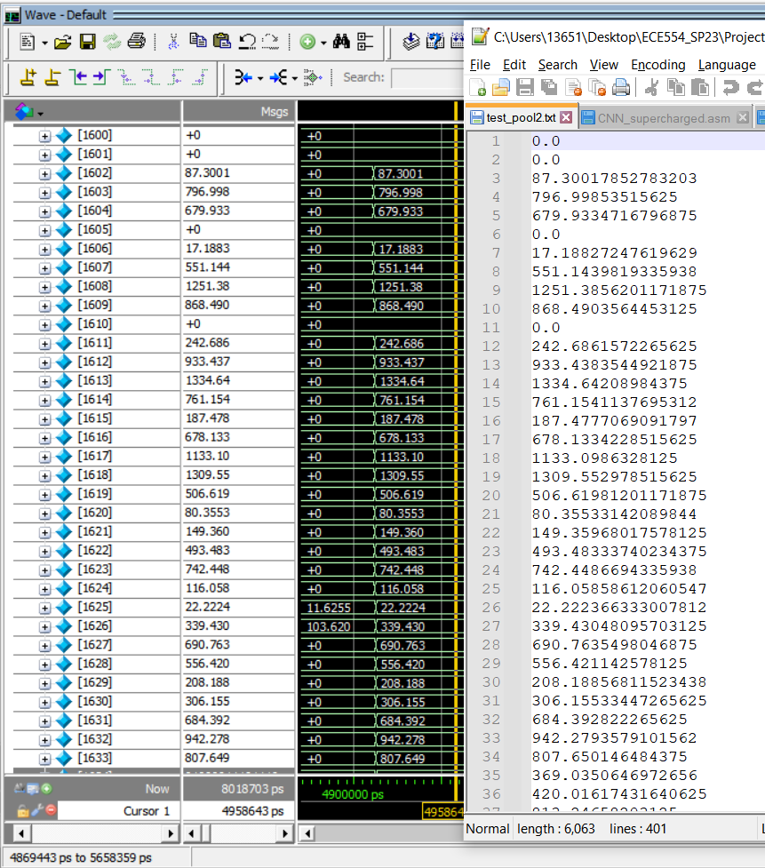
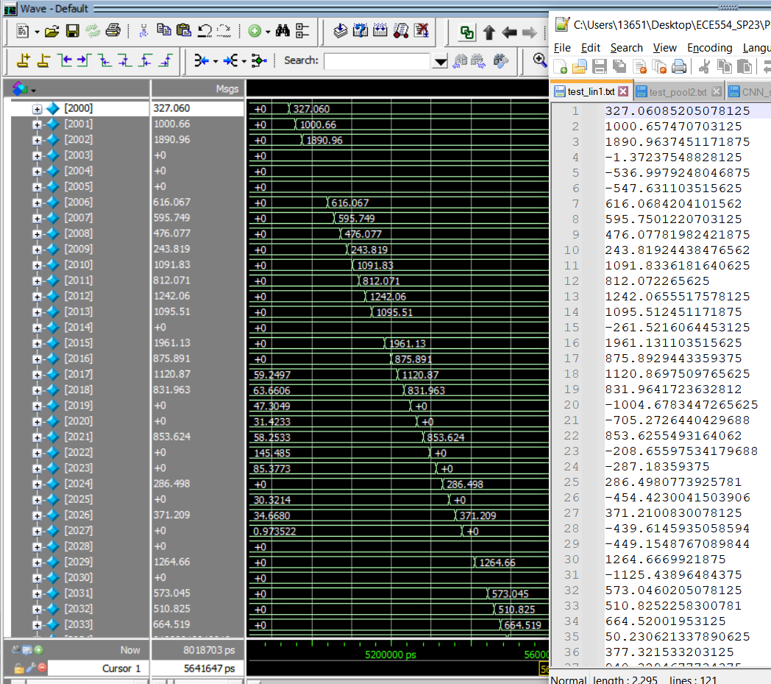
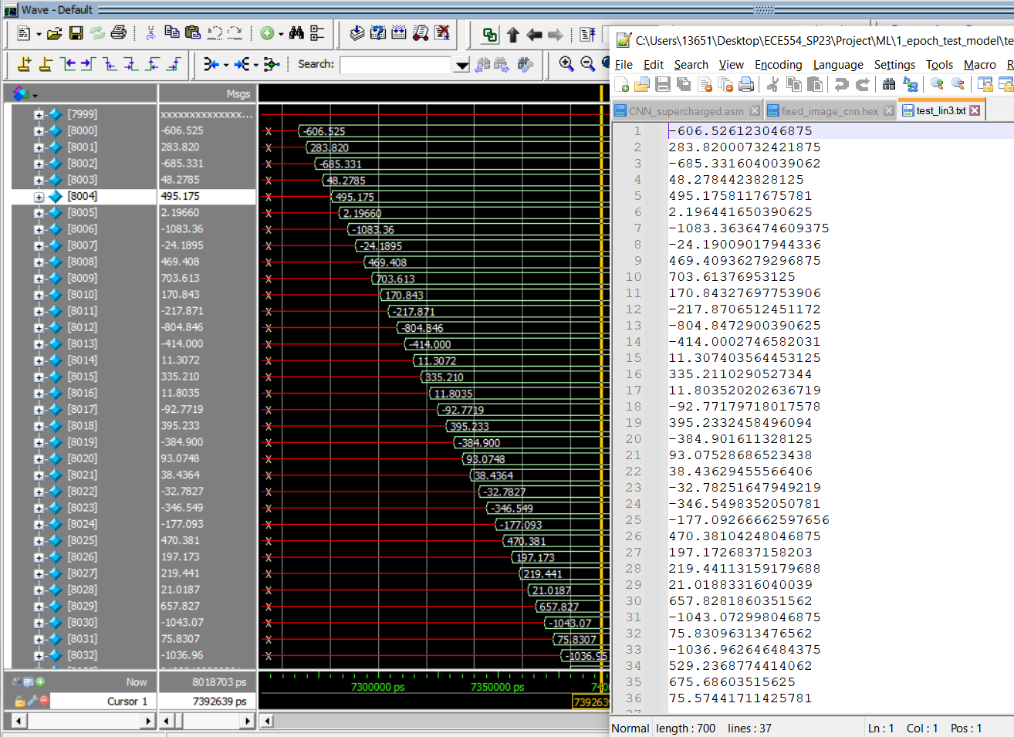
Top Level Validation

Slide 27
Self-Checking Assembly Tests and Python Auto-Tester
Fully Automated Processor Validation

Slide 28
ASM tests
assmbl_32.pl
cpu_tb.sv
test.py
umul.asm | subi.asm | subf.asm | sub.asm | srl.asm | sra.asm | sll.asm
poppush.asm | nor.asm | mulf.asm | mul.asm | lwsw.asm | llblhb.asm | jump.asm
ITF.asm | FTI.asm | branch.asm | and.asm | addi.asm | addf.asm | add.asm

Slide 29
Auto Tester - Python
python test.py help
python test.py <filename>.asm
python test.py
python test.py clean
vlog -work work -vopt -stats=none *.v *.sv
vlog -timescale 1ns/1ps cpu_tb.sv
perl asmbl_32.pl "+testFile+".asm > "+testFile+".hex
vsim -c work.cpu_tb -do 'run -all' > test.output
* Above commands run on linux machines

Slide 30
Assembly Firmware - Parameterized Machine Learning API
Fully Configurable Convolution, Pooling, Matrix Multiplication, and Other ML Classification Layers
Notes:
I am Haining, and I am going to walk you through our assembly code. Our firmware features parameterized function calls that is specifically designed for ML and thus form an Application Program Interface.

Slide 31
Overview
main(): an infinite loop
conv(): convolution function call
pool(): average pooling function call
matrix_mult(): matrix multiplication
findMax(): find a maximum value from a bunch of results
Notes:
This is an overview of our assembly code. The main function is just an infinite loop that repeatedly requests for an image, pre-processes the image, and triggers our algorithm. The CNN algorithm is splitted into several function calls each with their own task.

Slide 32
Convolutional Neural Network
400*120
120*84
(6*1*5*5)
(2*2, 2)
(16*6*5*5)
(2*2, 2)
84*36
Input size
32*32 = 1024
1*36
(28*28*6)
(14*14*6)
(10*10*16)
(5*5*16)
= 400
1*400
1*84
1*120
https://www.researchgate.net/figure/Methodology-A-convolutional-neural-network-CNN-was-trained-to-classify-handwritten_fig1_343547826
Notes:
Before we dive into the details, let me remind you of the CNN model. We have an input of 32*32 pixels, then we perform convolutions and poolings. The neural network involves 3 matrix multiplications, and the output layer has 36 results.

Slide 33
Overview
main()
loads image
pre-process
sets up params
calls functions
conv()
loads kernel
loads image
convolutes
stores to DM
returns
pool()
loads image
average pools
stores to DM
returns
conv()
pool()
matrix_mult()
multiply & add
stores to DM
returns
findMax()
finds max
sends to UART
Notes:
This graph shows how we achieved the algorithm using assembly code with function calls. The main function loads the image and convert the image pixels into floating point format. It sets up the parameters in the processor’s register file, including the starting address of the kernel and the image, the number of channels to repeat, and the target output address, and calls conv(). The conv function loads data from both kernel and the image pointed by the address parameter and perform convolutions and repeats these steps and returns. The main function again sets up parameters for pool function, such as the starting address of the image, the width of the image, and the number of channels to repeat. pool function loads the image from the starting address and perform an average pool to reduce the image size while maintaining the information. The main function does exactly the same thing in the following layers but passes different parameters to these functions. In the neural network, which essentially consists of several matrix multiplications, the main function again sets up some addresses of two matrix and let matrix_mult do its work. Finally in the output layer, main function calls findMax to send the result to UART and loops the entire process from the beginning.

Slide 34
Parameterized API
conv() params:
R2 | addr_kernel (start address of kernel)
R3 | addr_image (start address of image)
R4 | side_length_input
R6 | in_channel_length
R7 | out_channel_length
R29 | addr_output
pool() params:
R3 | layer starting address
R4 | image width
R6 | number of image channels
R29 | output starting address
matrix_mult() params:
R2 | pointer to weight matrix
R3 | pointer of image matrix
R4 | matrix size
Notes:
The wonderfulness of these parameterized function calls is that it creates a subtle abstraction level between the firmware and the high-level algorithm. With these API-like function call, it is fairly easy to switch to other Machine Learning applications, even if they might have different data dimensions and different layers of calculation. All we need to do is to call these functions and pass different parameters to them, and that is it. This makes our processor suitable for a wider range of ML applications and thus provides a higher level of generality.

Slide 35
Potential Impacts and Future Advancements
Reflections and Ending Thoughts
Notes:
That brings to the final part of our presentation. We want to share some thoughts on why we chose this project and its possible future development. Of course we chose to do it not because it is easy, but because we thought it would be easy.

Slide 36
A Trend: Edge Computing
Hardware means:
efficiency
reliability
scalability
Applications:
autonomous vehicle
healthcare monitoring
smart grid system
manufacturing
Notes:
The core paradigm behind this design is Edge Computing, which aims to bring computation and data storage closer to the location where the data is generated. By processing data locally and transmitting only the necessary data, edge devices reduce latency and bandwidth requirements, sometimes eliminating the need for data transmission. This approach improves reliability and scalability by distributing computing resources efficiently without relying on a centralized cloud infrastructure. Take, for example, a multimeter in a grid substation that is unable to transmit its voltage/current readings to the data center due to its lack of capability. Rather than redesigning the multimeter or hiring additional laborers, our design offers an instant and effective solution that connects the multimeter to the IoT, enabling transmission of data to others. It ultimately provides greater reliability and a non-stop monitoring capability.

Slide 37

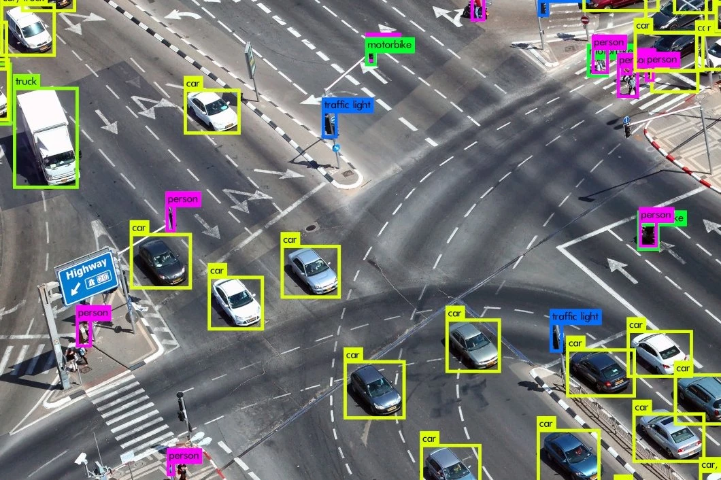
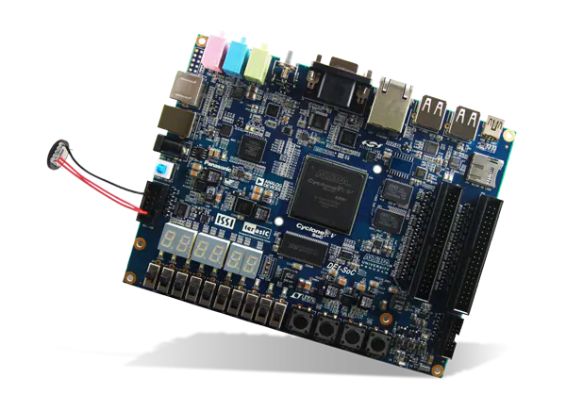
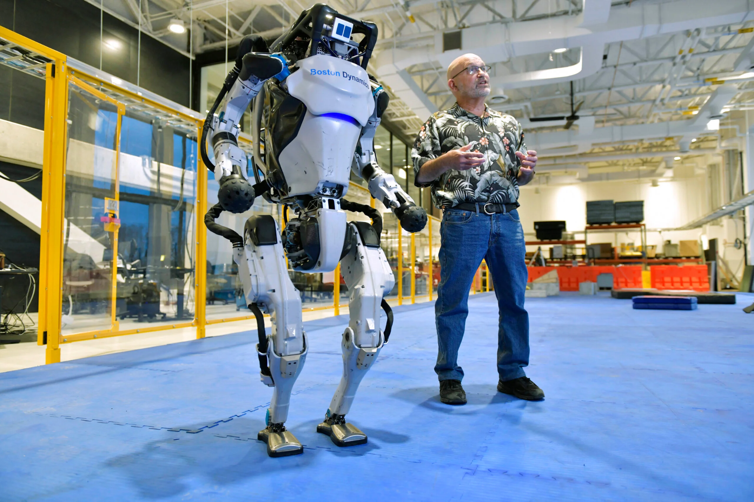

AI-Accelerating Processor Prototyping
Notes:
One way to continue our work is to redesign our ISA and the processor architecture to make it even more suitable for ML acceleration purpose. We can delete some of our unused instructions, employ a strong superscalar architecture, and push for a higher clock frequency. This prototype might eventually make any of these combinations come true.

Slide 38
TEAM POOR HANDWRITING
Qikun LIU, Shichen (Justin) QIAO, Haining QIU, Lingkai (Harry) ZHAO
Notes:
That concludes our presentation, we are TEAM POOR HANDWRITING, thank you for your attention.

